Slide 1
Questions for practice

Slide 2
Create DFA for
Accepts a string a followed by b{a,b}
Accepts a string containing even number of a’s and any number of b’s {a,b}
Accepts a string containing 2 consectutive a’s followed by 2 consectutive b’s {a,b}
Accepts a string that doesnot contain 3 consecutive a’s {a,b}

Slide 3
Create DFA for
Accepts a string that contains even number of 0’s and even number of 1’s
Ends with one b and even number of a’s
Accepts string aab
Accepts string that ends b not aa
Accepts a string that must not end withaa

Slide 4
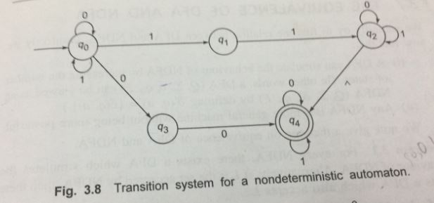
Convert NFA to DFA

Slide 5
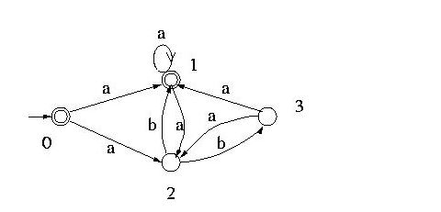
Convert NFA to DFA

Slide 6

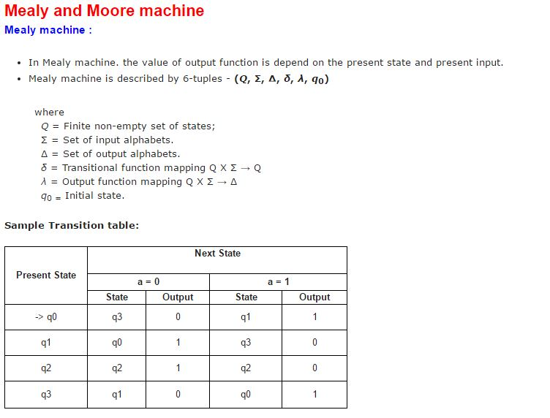
Convert from Mealy to Moore

Slide 7
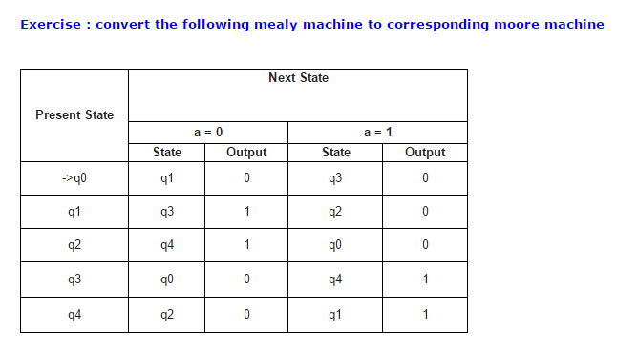
Convert mealy to moore

Slide 8
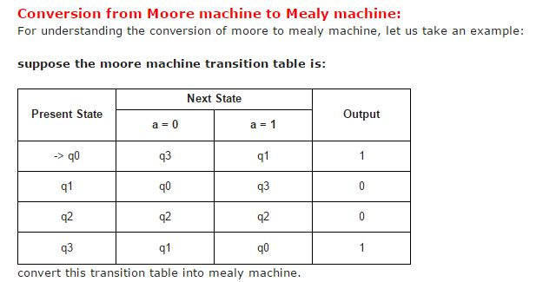
Convert from moore to mealy

Slide 9
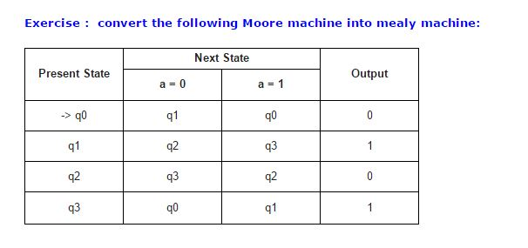
Convert from moore to mealy

Slide 10
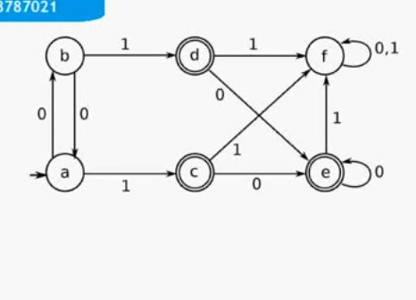
Minimize the automata

Slide 11
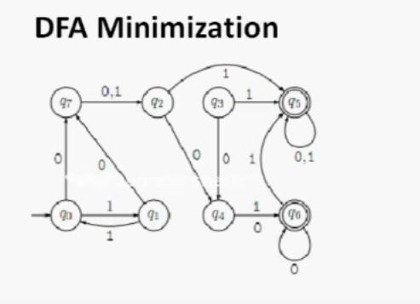
Minimize the automata

Slide 12
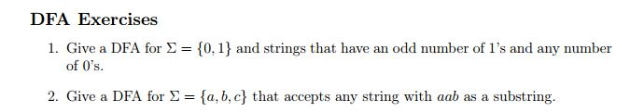
Construction of DFA Examples

Slide 13
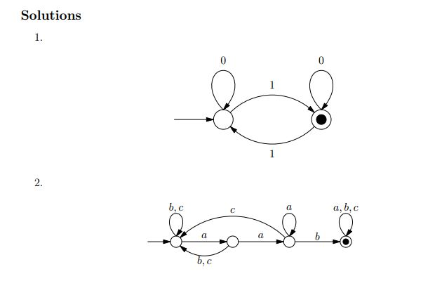
Answers

